Slide 1
Chapter 2
Database Environment
Pearson Education © 2014

Slide 2
Chapter 2 - Objectives
Purpose of three-level database architecture.
Contents of external, conceptual, and internal levels.
Purpose of external/conceptual and conceptual/internal mappings.
Meaning of logical and physical data independence.
Distinction between DDL and DML.
A classification of data models.
Pearson Education © 2014
‹#›

Slide 3
Chapter 2 - Objectives
Purpose/importance of conceptual modeling.
Typical functions and services a DBMS should provide.
Function and importance of system catalog.
Software components of a DBMS.
Meaning of client–server architecture and advantages of this type of architecture for a DBMS.
Function and uses of Transaction Processing Monitors.
Pearson Education © 2014
‹#›

Slide 4
Objectives of Three-Level Architecture
All users should be able to access same data.
A user’s view is immune to changes made in other views.
Users should not need to know physical database storage details.
Pearson Education © 2014
‹#›

Slide 5
Objectives of Three-Level Architecture
DBA should be able to change database storage structures without affecting the users’ views.
Internal structure of database should be unaffected by changes to physical aspects of storage.
DBA should be able to change conceptual structure of database without affecting all users.
Pearson Education © 2014
‹#›

Slide 6
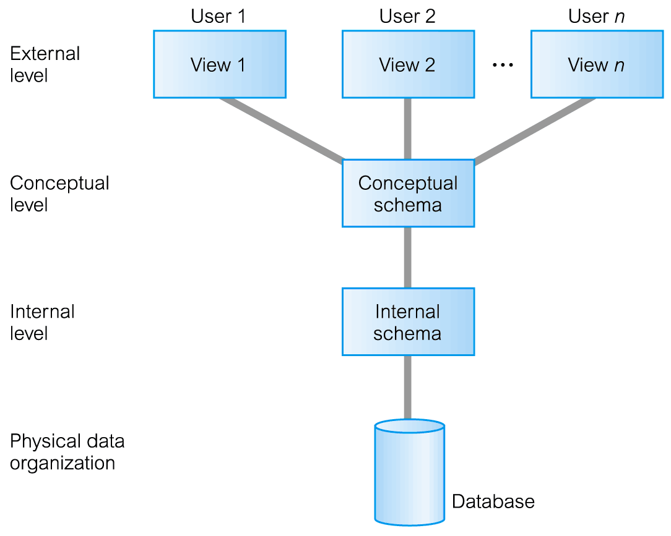
ANSI-SPARC Three-Level Architecture
Pearson Education © 2014
‹#›

Slide 7
ANSI-SPARC Three-Level Architecture
External Level
Users’ view of the database.
Describes that part of database that is relevant to a particular user.
Conceptual Level
Community view of the database.
Describes what data is stored in database and relationships among the data.
Pearson Education © 2014
‹#›

Slide 8
ANSI-SPARC Three-Level Architecture
Internal Level
Physical representation of the database on the computer.
Describes how the data is stored in the database.
Pearson Education © 2014
‹#›

Slide 9
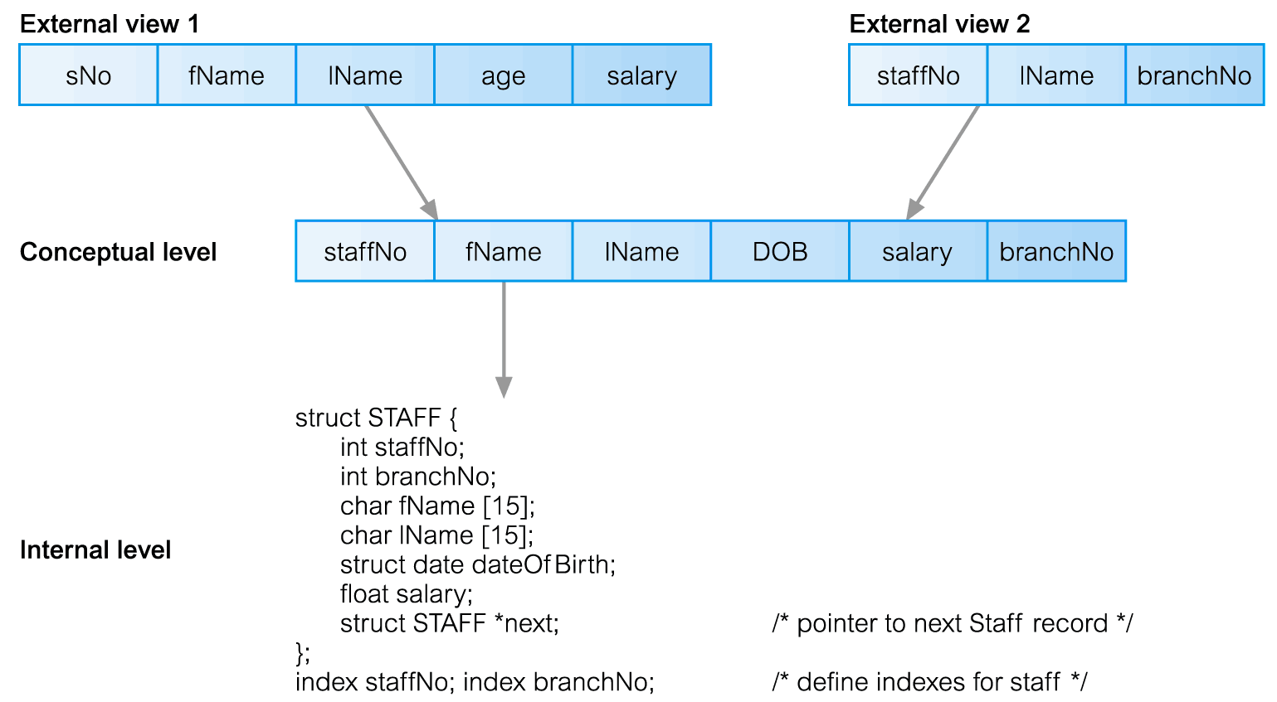
Differences between Three Levels of ANSI-SPARC Architecture
Pearson Education © 2014
‹#›

Slide 10
Data Independence
Logical Data Independence
Refers to immunity of external schemas to changes in conceptual schema.
Conceptual schema changes (e.g. addition/removal of entities).
Should not require changes to external schema or rewrites of application programs.
Pearson Education © 2014
‹#›

Slide 11
Data Independence
Physical Data Independence
Refers to immunity of conceptual schema to changes in the internal schema.
Internal schema changes (e.g. using different file organizations, storage structures/devices).
Should not require change to conceptual or external schemas.
Pearson Education © 2014
‹#›

Slide 12
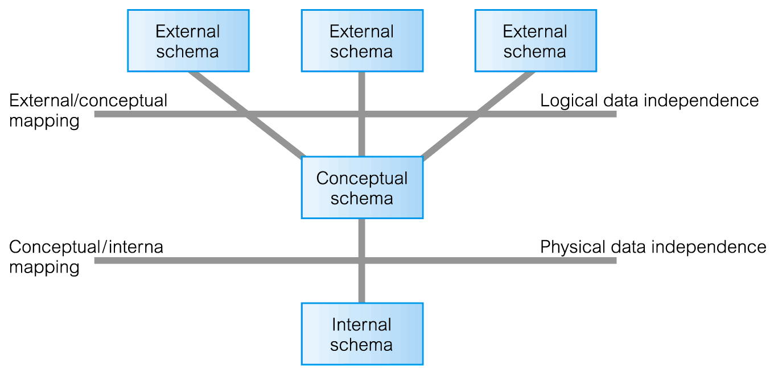
Data Independence and the ANSI-SPARC Three-Level Architecture
Pearson Education © 2014
‹#›

Slide 13
Database Languages
Data Definition Language (DDL)
Allows the DBA or user to describe and name entities, attributes, and relationships required for the application
plus any associated integrity and security constraints.
Pearson Education © 2014
‹#›

Slide 14
Database Languages
Data Manipulation Language (DML)
Provides basic data manipulation operations on data held in the database.
Procedural DML
allows user to tell system exactly how to manipulate data.
Non-Procedural DML
allows user to state what data is needed rather than how it is to be retrieved.
Fourth Generation Languages (4GLs)
Pearson Education © 2014
‹#›

Slide 15
Data Model
Integrated collection of concepts for describing data, relationships between data, and constraints on the data in an organization.
Data Model comprises:
a structural part;
a manipulative part;
possibly a set of integrity rules.
Pearson Education © 2014
‹#›

Slide 16
Data Model
Purpose
To represent data in an understandable way.
Categories of data models include:
Object-based
Record-based
Physical.
Pearson Education © 2014
‹#›

Slide 17
Data Models
Object-Based Data Models
Entity-Relationship
Semantic
Functional
Object-Oriented.
Record-Based Data Models
Relational Data Model
Network Data Model
Hierarchical Data Model.
Physical Data Models
Pearson Education © 2014
‹#›

Slide 18
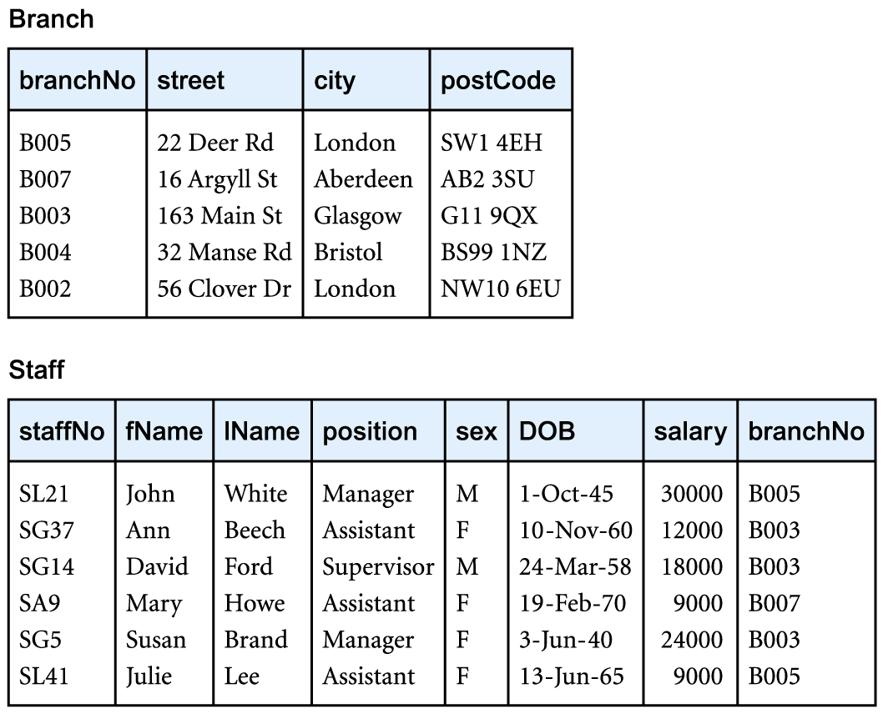
Relational Data Model
Pearson Education © 2014
‹#›

Slide 19
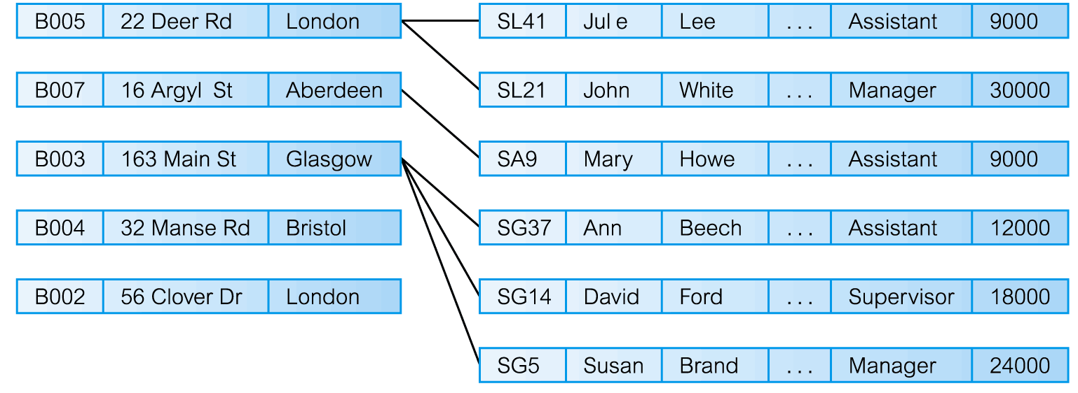
Network Data Model
Pearson Education © 2014
‹#›

Slide 20
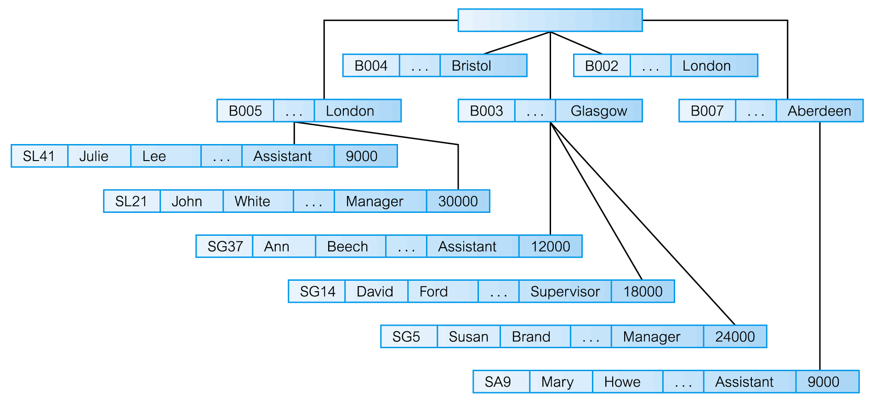
Hierarchical Data Model
Pearson Education © 2014
‹#›

Slide 21
Conceptual Modeling
Conceptual schema is the core of a system supporting all user views.
Should be complete and accurate representation of an organization’s data requirements.
Conceptual modeling is process of developing a model of information use that is independent of implementation details.
Result is a conceptual data model.
Pearson Education © 2014
‹#›

Slide 22
Functions of a DBMS
Data Storage, Retrieval, and Update.
A User-Accessible Catalog.
Transaction Support.
Concurrency Control Services.
Recovery Services.
Pearson Education © 2014
‹#›

Slide 23
Functions of a DBMS
Authorization Services.
Support for Data Communication.
Integrity Services.
Services to Promote Data Independence.
Utility Services.
Pearson Education © 2014
‹#›

Slide 24
System Catalog
Repository of information (metadata) describing the data in the database.
One of the fundamental components of DBMS.
Typically stores:
names, types, and sizes of data items;
constraints on the data;
names of authorized users;
data items accessible by a user and the type of access;
usage statistics.
Pearson Education © 2014
‹#›

Slide 25
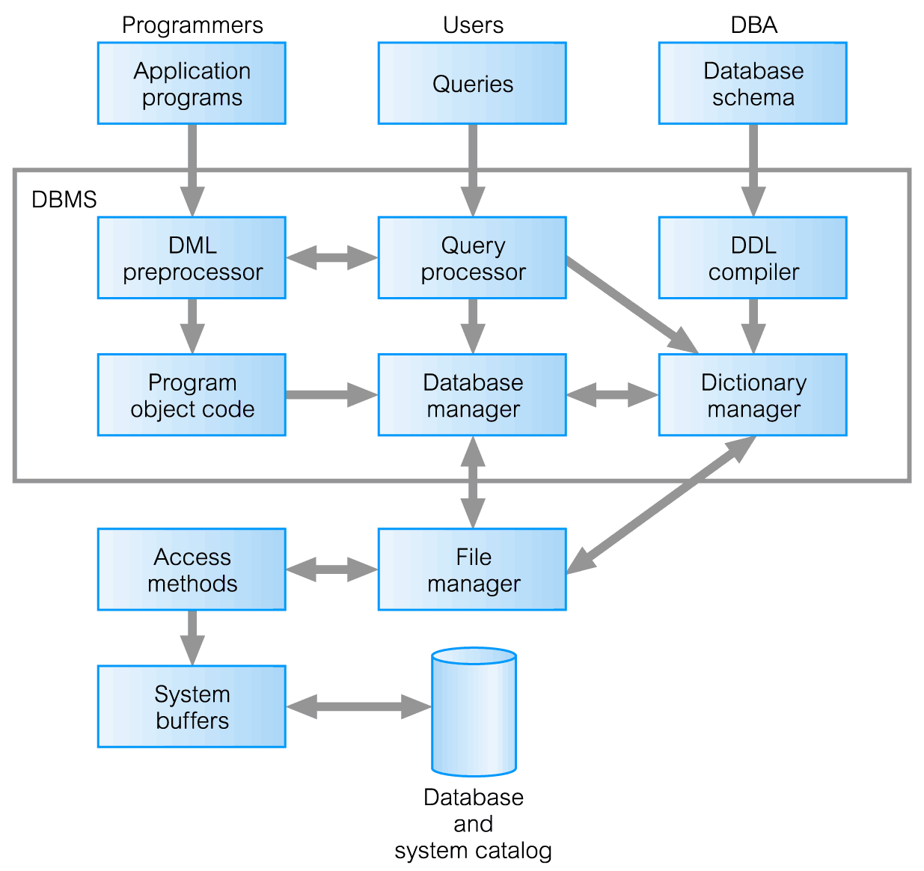
Components of a DBMS
Pearson Education © 2014
‹#›

Slide 26
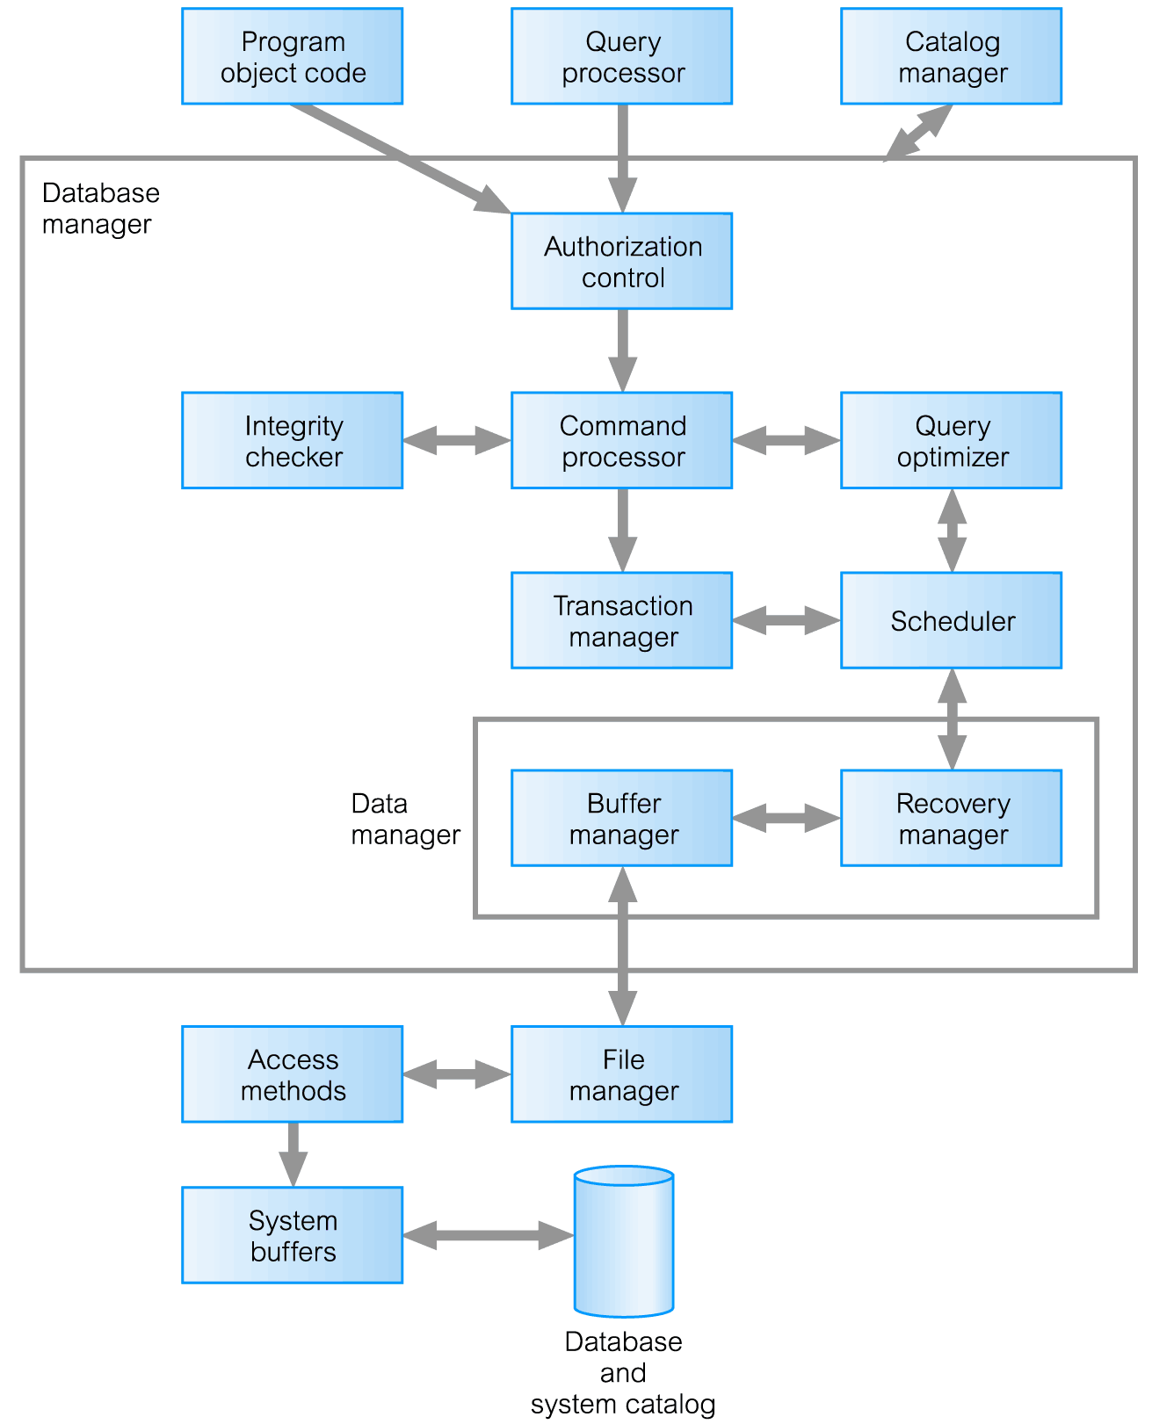
Components of Database Manager
Pearson Education © 2014
‹#›

Slide 27
Multi-User DBMS Architectures
Teleprocessing
File-server
Client-server
Pearson Education © 2014
‹#›

Slide 28
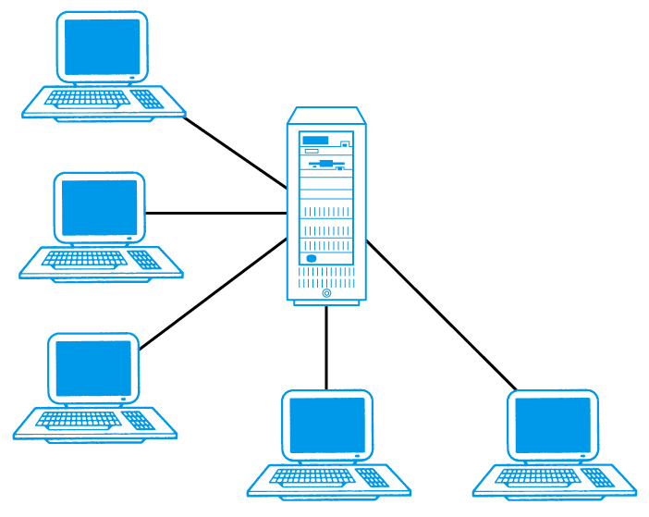
Teleprocessing
Traditional architecture.
Single mainframe with a number of terminals attached.
Trend is now towards downsizing.
Pearson Education © 2014
‹#›

Slide 29
File-Server
File-server is connected to several workstations across a network.
Database resides on file-server.
DBMS and applications run on each workstation.
Disadvantages include:
Significant network traffic.
Copy of DBMS on each workstation.
Concurrency, recovery and integrity control more complex.
Pearson Education © 2014
‹#›

Slide 30
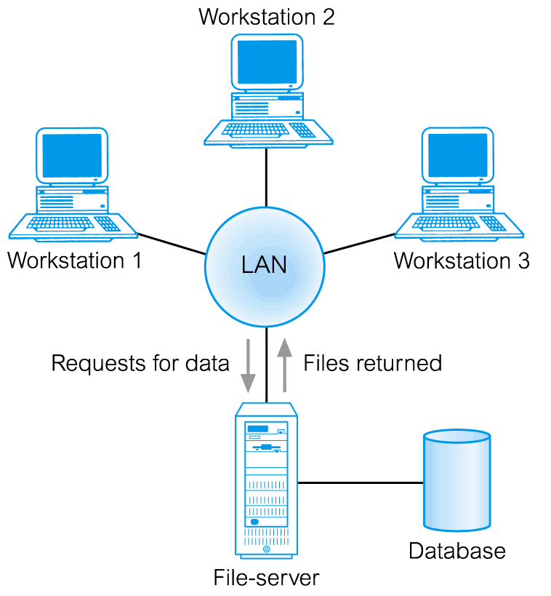
File-Server Architecture
Pearson Education © 2014
‹#›

Slide 31
Traditional Two-Tier Client-Server
Client (tier 1) manages user interface and runs applications.
Server (tier 2) holds database and DBMS.
Advantages include:
wider access to existing databases;
increased performance;
possible reduction in hardware costs;
reduction in communication costs;
increased consistency.
Pearson Education © 2014
‹#›

Slide 32
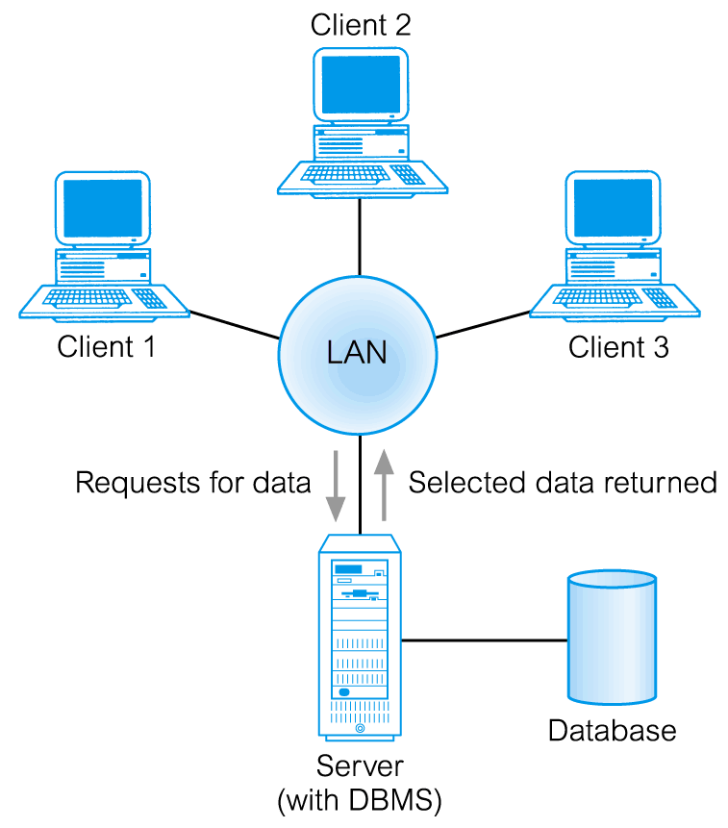
Traditional Two-Tier Client-Server
Pearson Education © 2014
‹#›

Slide 33
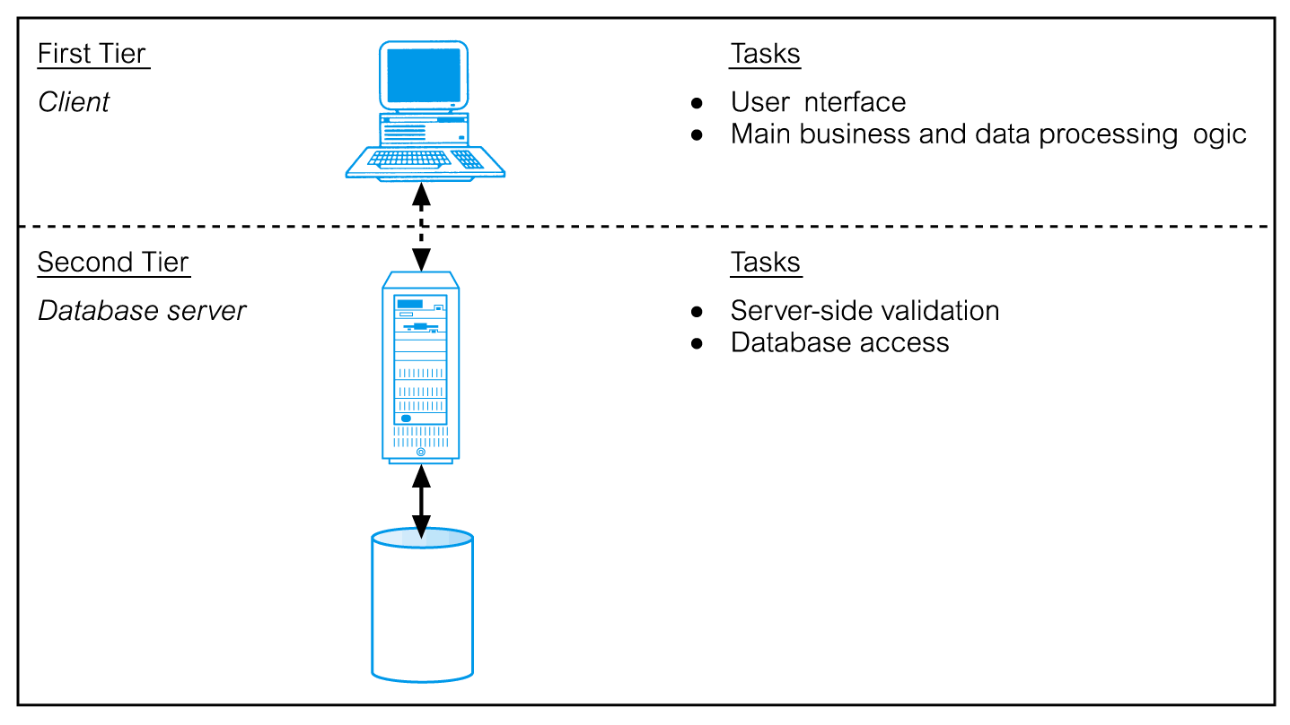
Traditional Two-Tier Client-Server
Pearson Education © 2014
‹#›

Slide 34
Three-Tier Client-Server
Client side presented two problems preventing true scalability:
‘Fat’ client, requiring considerable resources on client’s computer to run effectively.
Significant client side administration overhead.
By 1995, three layers proposed, each potentially running on a different platform.
Pearson Education © 2014
‹#›

Slide 35
Three-Tier Client-Server
Advantages:
‘Thin’ client, requiring less expensive hardware.
Application maintenance centralized.
Easier to modify or replace one tier without affecting others.
Separating business logic from database functions makes it easier to implement load balancing.
Maps quite naturally to Web environment.
Pearson Education © 2014
‹#›

Slide 36
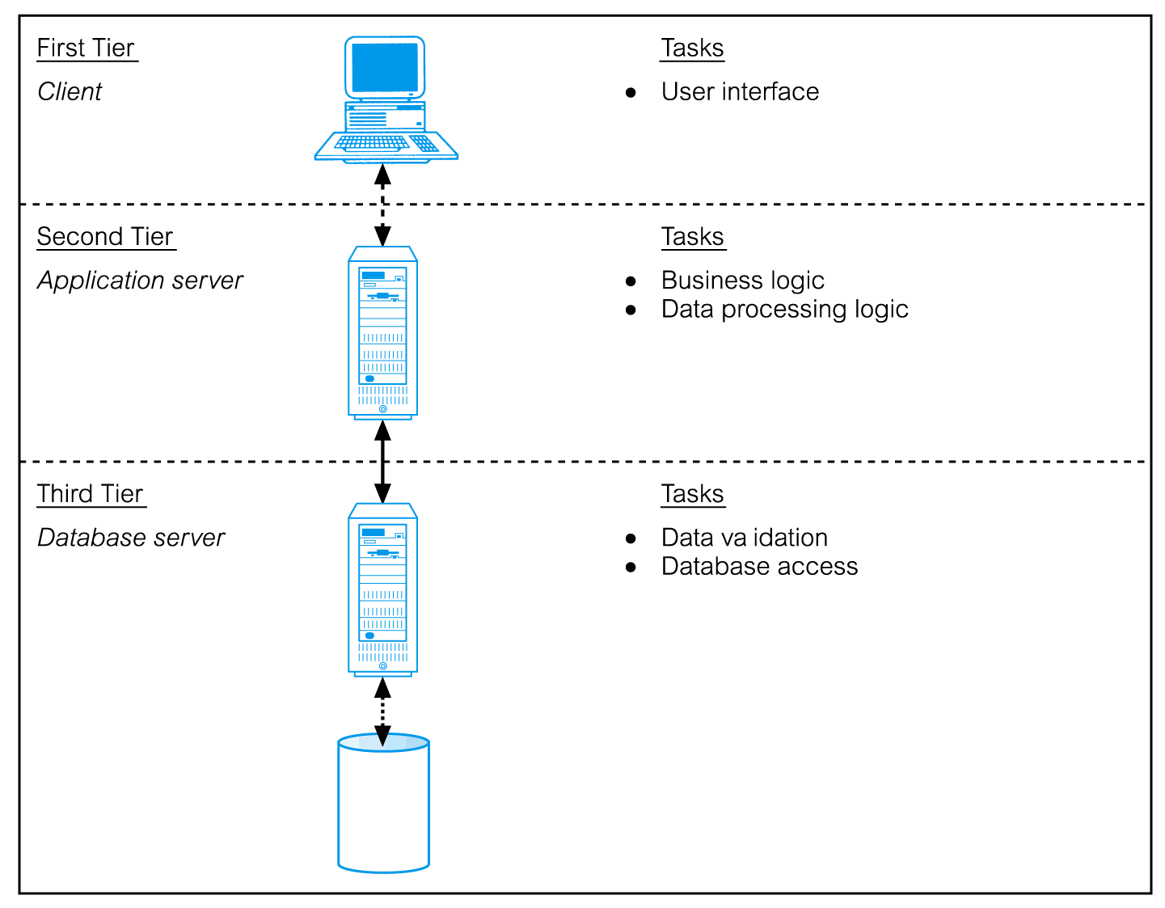
Three-Tier Client-Server
Pearson Education © 2014
‹#›

Slide 37
Transaction Processing Monitors
Program that controls data transfer between clients and servers in order to provide a consistent environment, particularly for Online Transaction Processing (OLTP).
Pearson Education © 2014
‹#›

Slide 38
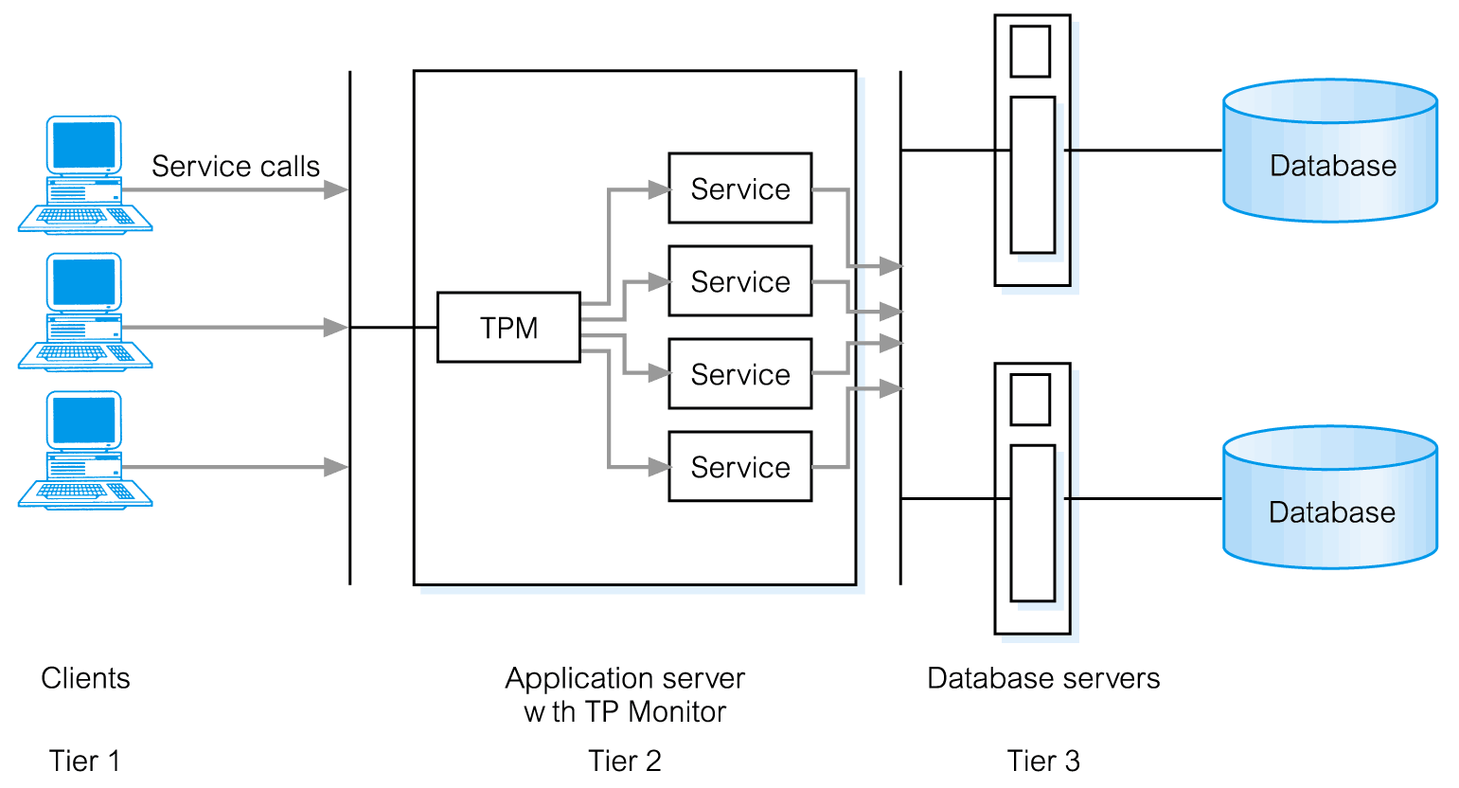
TPM as middle tier of 3-tier client-server
Pearson Education © 2014
‹#›

